Slide 1
Parametric variation in discourse configurationality
Jenneke van der Wal
Tim Bazalgette

Slide 2
Second annual conference centred around
‘Diagnosing syntactic focus’
10 & 11 May 2013
Speakers: David Beaver (tbc), Ad Neeleman, Hans van de Koot, Stavros Skopeteas, Enoch Aboh, Susanne Winkler, Aritz Irurtzun
Notes:
Call will be announced for first day of comparative papers, deadline January.

Slide 3
Introduction
Configurationality
non-configurationality
discourse configurationality
Cartography
Alternatives to cartography
Features
ReCoS
Programme workshop

Slide 4
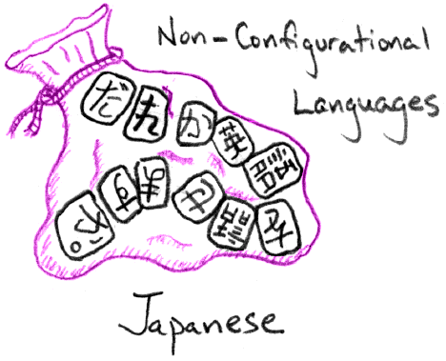
Configurationality
Cartoon Theories of Linguistics (Speculative Grammarian at http://specgram.com)

Slide 5
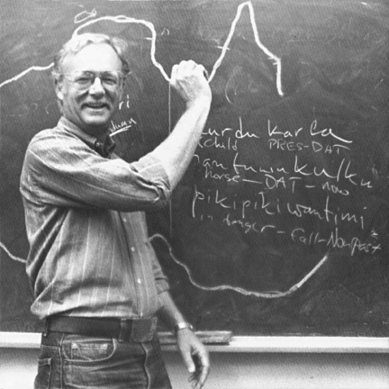
Non-Configurationality
Ken Hale (1983)
Characteristics
free word order
pro-drop
discontinuous NPs
(case marking)
Notes:
Different definitions of configurationality and non-configurationality. Started with Hale who suggested Australian Warlpiri was non-configurational. He described 3 characteristics which can be taken to define a non-configurational language. Case marking was later observed to often go together with the other properties.

Slide 6
Non-Configurationality
Grammatical functions (not) distinctively encoded by phrase structure (Bresnan & Mchombo 1987, Baker 2001)
Flat structure; no VP node
--> No configuration?!
subject
VP
subject
verb
object
verb
object
Notes:
Hale & Chomsky formalised this notion saying that a language has a VP node (asymmetric) or not (symmetric). In symmetric languages word order is simply stringing words together, Chomsky (1981) ‘assume grammatical function’.
So a language can be ‘non-configurational’ if it 1. has all the set characteristics, or 2. if it shows no sign of a VP node or asymmetry, or 3. if the surface phrase structure configuration does not encode grammatical functions.
It makes you wonder where there is really the possibility to have no configuration.

Slide 7
Configurationality
Hale (1989:294)
“the term ‘configurationality’ is not a particularly appropriate one, since the notion ‘configuration’, in the sense of a hierarchical organisation of constituents, is essential to all languages.”

Slide 8
Non-Configurationality
configuration only underlying, not surface
morphology = arguments, NPs = adjuncts (Jelinek 1983, Baker 1996 ‘polysynthesis’)
Phrase structure configuration - constituency - word order
--> so if not by grammatical functions, what is the configuration determined by?
Notes:
Discovery of more ‘configurational’ properties in ‘non-configurational’ lgs made the P&P framework propose underlying phrase structure, disrupted at surface structure. What You Start Is Not What You Pronounce. Parametric variation in how direct link betw underlying an surface representation.
Jelinek: projection principle holds at surface structure. Parametric variation in the ability to encode arguments on verb.
What is meant by configuration in this literature is constituency and word order; word order is what discourse-configurationalists have focused on.

Slide 9
Discourse Configurationality
Li and Thompson (1976)
subject – predicate
topic – comment!
Katalin É. Kiss (2001)
“We call a language discourse-configurational if it links either or both of the discourse-semantic functions topic and focus to particular structural positions.”
Notes:
Some lgs listed as non-conf are also mentioned as disc-conf and there is a natural link between the two, even though the research on non- and disc-conf developed side-by-side over the 80s and 90s – stil distinct for some, cf. Pensalfini.
Word order variation is not random or free. The idea that discourse-semantic notions can be expressed in structural relations is not new; there were already many such ideas in more functional traditions (Prague School, Sgall, Hajicova), then combined with formal syntactic accounts, e.g. Jackendoff 1972, Horvath 1981.
Li and Thompson: subject-prominent and topic-prominent: structural position not just for syntactic but also discourse functions.
The parametric variation is in whether lg has such a structural position or not, or what functions certain structural positions are linked to, but that has various ways of implementation.

Slide 10
Discourse Configurationality
Main questions:
overall property of language?
where is dedicated position?
how to account for language variation?
Notes:
(address these three questions in next slides)

Slide 11
X-configurational languages?
Hale (1989:294,299)
“nonconfigurationality is not a global property of languages; rather, it is a property of constructions.”
“I suspect strongly that there is no single ‘parameter’ giving rise to the various properties commonly associated with the term ‘non-configurational’.”
Öhl (2010:231)
“The more recent the research on this topic, the more common the opinion that there is no real sharp division between [discourse-configurational languages and ‘syntax-configurational ones’].”
Notes:
Wrt the first and third question, we can find a similar answer for non-configurationality and disc-conf. Both suggest the relevant properties are to be found on a lower level, making configurationality more of a continuum.

Slide 12
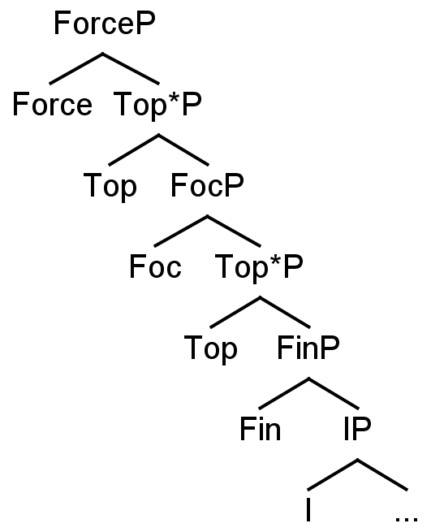
Cartography
Rizzi’s (1997) map of the left periphery.
Cinque (1999) adverb positions.
Hierarchy and order of functional projections is universal.
Notes:
Wrt second question (where is position):
Cartography is the dominant syntactic approach to the investigation of information structural positions.
This arose as a continuation of the “splitting” of categories that began in the late GB era (e.g. Pollock 1989 For IP).
Rizzi (1997) was probably the first truly cartographic work, which gave a detailed map for the structure of the left periphery and information-structural positions within it.
This continued with Cinque (1999), with his articulated IP structure based on adverb positions.
Central hypothesis that this fine hierarchy and order of functional projections is universal.

Slide 13
Expansions to cartography
Fine tuning of left periphery (Rizzi 2004, Frascarelli & Hinterhölzl 2007)
“Low left periphery” for the vP (e.g. Belletti 2001, 2004)
Cartographic approaches taken by Pan, Varley, Walkden, and Cognola.
Notes:
Cartographic work on information structure continues in full force today, with updated left peripheries (Rizzi 2004 and Frascarelli and Hinterhölzl 2007 inter alia) and research into a similar “low left periphery” for the VP (e.g. Belletti 2001, 2004).
Thus ongoing research is leading to ever-more comprehensive mappings of information-structural positions within the clause.
This is further expanded by many of the speakers at this workshop – Pan analyses the left periphery of Mandarin Chinese, Varley examines the connection between evidentiality and logophoric features in the high C domain, Walkden considers a cartographic perspective for heavy NP shift in Old Saxon, and Cognola investigates the interaction of cartographic positions with the V2 parameter.

Slide 14
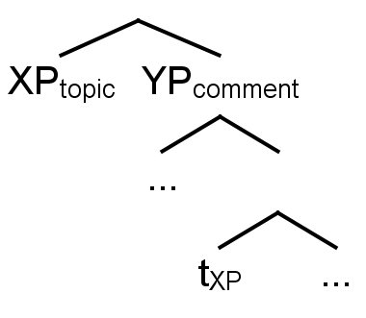
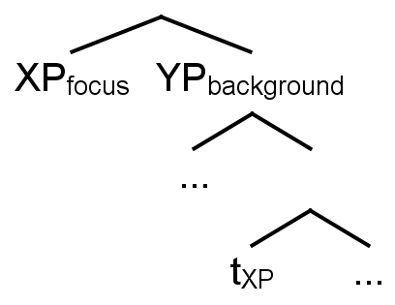
Alternatives to cartography
Neeleman & van der Koot (2008), Kucerova & Neeleman: syntax mapped to information structure at the interfaces.
x
Notes:
Cartography is by no means the only modern approach to syntactic information structure, with their being various other perspectives.
For instance, one leading alternative (Neeleman and van der Koot 2008, Kucerova and Neeleman forthcoming) argues that syntax is mapped to information structure at the interface, with movements being driven by the necessity of the complements of topics and foci to be constituents at the interface.

Slide 15
Alternatives to cartography
Fanselow (2006): “the impact of information structure on syntax is an indirect one, mediated primarily by … prosodic manifestations.”
Variation restricted to PF interface, c.f. Berwick and Chomsky (2011): “parameterization and diversity [could be] mostly – possibly entirely – restricted to externalization.”
More critical assessments of cartography made by Erteschik-Shir and Walkden.
Notes:
Still others argue that information structure is not explicitly encoded in the syntax - e.g. Fanselow (2006) quote.
Under such approaches, variation is largely restricted by the PF interface, and so is largely compatible with the general approach outlined by Berwick and Chomsky (2011).
This perspective on variation is argued for in this workshop by Erteschik-Shir, who argues crosslinguistic variation in superiority effects supports the idea that displacement is constrained by PF rather than narrow syntax.
Furthermore, Walkden partially argues against a cartographic account, suggesting that there may not be a one-to-one relation between focus and heavy NP shift, with grammatical weight also playing a role.

Slide 16
Variation in Cartography
Universal projections
Variation = overt realisation & type of movement (cf. Cinque and Rizzi 2008)
Frascarelli and Hinterhölzl (2007):
Italian: [_{ShiftP} _{[+aboutness]} [_{ContrastiveP} [_{FocP} [_{FamiliarP} [_{IP} …
German: [_{ShiftP [+aboutness]} [_{ContrastiveP} [_{FamiliarP} [_{IP} …
Notes:
A central hypothesis of cartography is that “the distinct hierarchies of functional projections … may be universal in the type of heads and specifiers that they involve, in their number, and in their relative order, even if languages differ in the type of movements that they admit or in the extent to which they overtly realize each head and specifier.” (Cinque and Rizzi 2008)
Thus variation is perhaps secondary to providing an accurate (universal) map of the clause; for instance, Frascarelli and Hinterhölzl (2007) suggest different peripheries for German and Italian. The languages thus differ only in the presence of the FocP projection, but the universality of the hierarchies is maintained.

Slide 17
Variation in Features
Variation = features on functional heads.
Information-structural movements triggered by presence/absence of features.
The Borer-Chomsky Conjecture: “All parameters of variation are attributable to differences in the features of particular items (e.g. the functional heads) in the lexicon.” (Baker 2008)
Notes:
Supposing a universal clausal hierarchy can be maintained, the differences between languages may be reduceable simply to differences in features on these functional heads.
Whether we use criterial positions (Rizzi 1996), checking theory (Chomsky 1993, 1995), or a probe-goal agree system (Chomsky 2001), it can be argued that languages show overt information-structural movement when the relevant functional heads have e.g. strong features/EPP diacritics.
Thus cartography provides a framework for detailed microparametric analysis, which is in line with the Borer-Chomsky conjecture.

Slide 18
Discourse configurationality?
Unconstrained microvariation?
Does this mean we should abandon a discourse configurationality macroparameter, as suggested earlier?
Notes:
So modern syntactic approaches to parametric variation in information structure are in line with current minimalist thinking.
However, such perspectives predict unconstrained microvariation – does this mean we should abandon a discourse configurationality macroparameter, as suggested earlier?

Slide 19
Emergent hierarchies of microparameters, giving macroparametric effects:
Learning pathways, typological and diachronic predictions
Notes:
The basic idea of ReCoS is that parameters form hierarchies from macro- to micro-, for the presence of a feature in the language and on certain heads. Ex: if all heads have the head-finality movement trigger, the language is rigidly head-final, with more complex distributions of features being further down the tree. These are therefore putative learning pathways where the child acquires the features and goes down the hierarchy to see how the feature is distributed in his/her grammar. Moreover, it makes typological predictions, and possibly implies restrictions on diachronic change as well.
Could such a hierarchy exist for discourse-related features?

Slide 20
Uncovering discourse parameters
Structure in IS microparametric variation?
Anything like a discourse configurationality (macro)parameter?
Only superficial effects?
More data!

Slide 21
Programme
Wednesday 29 August
11.30-12 Frederica Cognola Discourse-configurationality as an effect of the V2 parameter: the case of Mocheno
12-12.30 Victor Pan Syntactic representation of Discourse-configurationality in Mandarin
12.30-13 Nadia Varley Towards a unifying syntactic account of logophoricity, evidentiality, TNS and agreement
lunch
14.30-15 Lutz Marten Variation in Bantu subject inversion constructions
15-15.30 Jenneke van der Wal Why does focus want to be adjacent to the verb?
15.30-16 Guglielmo Cinque discussion
Thursday 30 August
9-9.30 George Walkden Object position and Heavy NP Shift in Old Saxon and beyond
9.30-10 Nomi Erteschik-Shir Optimal alignments of syntactic and information structure configurations: variation in superiority effects
10-10.30 Discussion
Notes:
Workshop: Marten and van der Wal provide detailed typological data, Pan and Varley extend the cartographic approach, Erteschik-Shir and Walkden examine cartographic assumptions more critically, and Cognola investigates more macroparametric information-structural behaviour.

Slide 22
References
Baker, Mark. 1996. The Polysynthesis Parameter. Oxford University Press, Oxford/New York.
Baker, Mark. 2001. The Natures of Non-Configurationality. In: Mark Baltin and Chris Collins (eds.), Handbook of Syntax. Blackwell, Oxford, 407-438.
Baker, Mark. 2008. The macroparameter in a microparametric world. In The Limits of Syntactic Variation, edited by Theresa Biberauer, 351-374. Amsterdam: John Benjamins.
Belletti, Adriana. 2001. Inversion as focalization. In Subject inversion in Romance and the theory of universal grammar, edited by A. Hulk and J. Y. Pollock, 60-90. New York: Oxford University Press.
Belletti, Adriana. 2004. Aspects of the low IP area. In The Structure of CP and IP, edited by Luigi Rizzi, 16-51. Oxford: Oxford University Press.
Berwick, Robert, and Noam Chomsky. 2011. Biolinguistics: The current state of its evolution and development. In Biolinguistic investigations, edited by Anna M. Di Sciullo and Cedric Boeckx, 19–41. Oxford: Oxford University Press.
Chomsky, Noam. 1981. Lectures on Government and Binding. Dordrecht: Foris.
Cinque, Guglielmo. 1999. Adverbs and Functional Heads: a Cross-Linguistic Perspective. Oxford: Oxford University Press.
É. Kiss, Katalin, ed. 1995. Discourse Configurational Languages. New York: Oxford University Press.
É. Kiss, Katalin. 2001. Discourse configurationality. In Martin Haspelmath and Ekkehard König (eds), Sprachtypologie und sprachliche Universalien. Ein internationales Handbuch, 1442-1452. Berlin: Mouton de Gruyter.
Fanselow, Gisbert. 2006. On pure syntax (uncontamined by information structure). In: Brandt, P., Fuss, E. (Eds.), Form, Structure and Grammar. Akademie Verlag, Berlin, pp. 137–158.
Frascarelli, Mara, and Roland Hinterhölzl. 2007. Types of topics in German and Italian. In: Susanne Winkler, Kerstin Schwabe (Eds), On Information Structure, Meaning and Form. John Benjamins, Amsterdam/Philadelphia, pp. 87–116.
Hale, Kenneth. 1983. Warlpiri and the grammar of non-configurational languages. Natural Language and Linguistic Theory 1:5-47.
Hale, Kenneth. 1989. ‘On Nonconﬁgurational Structures’, in L. Marácz and P. Muysken (1989), pp. 293–300.
Jackendoff, Ray. 1972. Semantic Interpretation in Generative Grammar. MIT Press, Cambridge, MA. Li, Charles N., and Sandra A. Thompson. 1976. Subject and topic: a new typology of language. In Subject and Topic, edited by Charles Li, 457-490. New York: Academic Press.
Jelinek, Eloise. 1984. ‘Empty categories, case and configurationality’. Natural Language and Linguistic Theory 2, 39 -76.
Neeleman, Ad & Hans van de Koot. 2008. Dutch scrambling and the nature of discourse templates. Journal of Comparative Germanic Linguistics 11. 137–189.
öhl, Peter. 2010. Formal and functional constraints on constituent order and their universality. In Carsten Breul (ed), comparative and contrastive studies of information structure.Amsterdam: John Benjamins.
Pensalfini, Rob. 2004. Towards a typology of configurationality. NLLT 22: 359-408.
Rizzi, Luigi. 1997. The Fine Structure of the Left Periphery. In Elements of Grammar, edited by Liliane Haegeman, 281-337. Kluwer, Dordrecht.
Rizzi, Luigi. 2004. Locality and Left Periphery. In Structures and Beyond: The Cartography of Syntactic Structures, volume 3, edited by Adriana Belletti, 223-251. New York: Oxford University Press.

